Slide 1
Behavioral Health and Substance Use Super-Utilizers
Icon FPO
Restoring Lives and Reducing Costs
February 10, 2016 Johnny Gore, MD Senior Medical Director

Slide 2
The Challenge
Data analysis revealed that members with primary behavioral health and substance use disorders resulted in higher cost services and unusual use patterns
Apart from transplants and a few extraordinary drug costs, 21 of the top 25 most expensive members were noted to have primary behavioral health and substance use diagnoses
These diagnoses were the primary cost and utilization drivers for our most expensive top five percent of members
Discovered patterns of repeated Emergency Room (ER) use and hospital readmission rates that far exceeded all other member risk groups
Hospital admissions for some of these members occurred twice a month
High encounter rates with the judicial system (criminal and civil)
Lack of support groups and caregivers

Slide 3
Approach
Redefine the home health model of care
Removal of authorization limits with the close consultation and guidance of the plan Medical Director
Empowering the nurse to, “Do whatever it takes to keep the member living as independently as possible in the community”
Contracted Nurse to spend as much time as necessary and to visit the member as frequently as needed to comprehensively address all of the member’s needs
Remove boundaries between areas of member need. Member needs may extend across physical health, behavioral health, and socioeconomic domains

Slide 4
The beginning
Started in August 2012
Member referrals: Behavioral health STAR+PLUS members with the highest acuity, most hospital admissions, highest degrees of noncompliance and recidivism, highest abuse of alcohol and illicit substances
Number of member referrals in 2012:
August: 15
September: 2
October: 12
November: 3
December: 13
Total members referred in 2012: 45
Cigna-HealthSpring STAR+PLUS Medical Director coordinates referrals and leads weekly clinical rounds between health plan staff and contracted nurses

Slide 5
initiation
ALL paid claims associated with initial 15 referred patients in August 2012
Cost of program is included
Cost of program is not administrative, it is medical as it is billed by provider
Cost/Month for All Claim Sources for All Program Members

Slide 6
2012 Total program
ALL paid claims associated with all 45 referred patients, 2012 data (March-December)
Cost/Month for All Claim Sources for All Program Members

Slide 8
2012 LOOK BACK

Slide 9
Sustainability: 2013 Pre Enrollment Compared to 2014 Post Enrollment
Top 10 Most Frequently Admitted Members | Total Admits Pre-Enroll | MLR Pre-Enroll | Total Admits Post-Enroll | MLR Post-Enroll
1 | 26 | 481.60% | 2 | 187.08%
2 | 22 | 2348.05% | 9 | 773.97%
3 | 21 | 907.70% | 15 | 466.36%
4 | 19 | 816.05% | 18 | 637.83%
5 | 13 | 536.55% | 5 | 242.44%
6 | 12 | 227.56% | 8 | 137.25%
7 | 11 | 568.88% | 11 | 482.52%
8 | 11 | 176.66% | 2 | 195.01%
9 | 11 | 670.77% | 1 | 704.55%
10 | 10 | 316.25% | 2 | 104.82%
 | 156 |  | 73

Slide 10
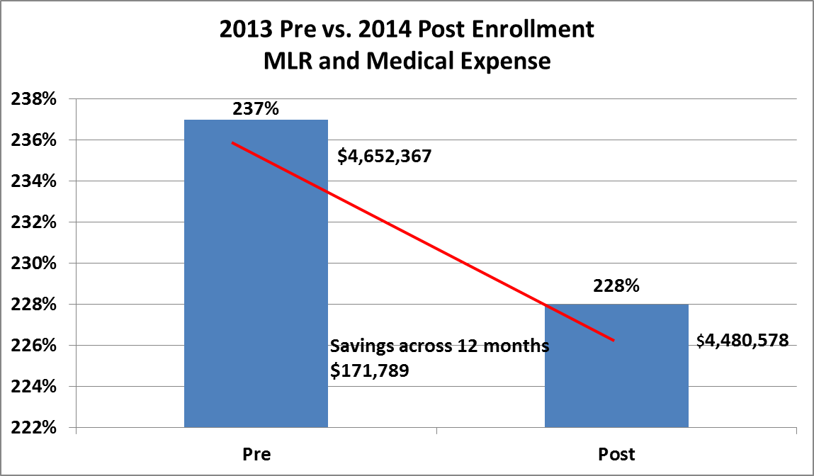
Sustainability: 2013 Pre Enrollment Compared to 2014 Post Enrollment

Slide 11
OUTCOMES
A male member with schizophrenia who lived under a bridge was reunited with his family, became medication compliant, and had a reduction in his medical loss ratio from 513% to 289%.
A female with schizophrenia was previously alienated from her family. Her psychosis had invaded her ability to maintain a healthy relationship with her children. With assistance from the program, she was court committed to a psychiatric facility. That court commitment was then modified to the outpatient setting. With mandated compliance by the court, monitored by the nurses of the program, the member’s psychosis was controlled. The member’s family saw such improvement that she was allowed to attend her oldest son’s graduation from a military boot camp, and her youngest son’s graduation from high school.
A male member with methamphetamine addiction and a cardiac ejection fraction of 20% was relocated from a crack house to an assisted living facility. The change in living conditions improved his medication compliance and sobriety. His medical loss ratio was reduced from 462% to 300%.
A homeless female member with chronic psychosis was taken off the streets and reunited with her family. Her primary psychosis was controlled. Her medical loss ratio was reduced from 513% to 250%.
A female with histrionic personality traits had twice a month psychiatric hospitalizations for years. After enrollment in the program, her admittance rate declined to two times in the last year.

Slide 12
All Cigna products and services are provided exclusively by or through operating subsidiaries of Cigna Corporation, including Cigna Health and Life Insurance Company, Cigna HealthCare of South Carolina, Inc., Cigna HealthCare of North Carolina, Inc., Cigna HealthCare of Georgia, Inc., Cigna HealthCare of Arizona, Inc., HealthSpring Life & Health Insurance Company, Inc., HealthSpring of Tennessee, Inc., HealthSpring of Alabama, Inc., HealthSpring of Florida, Inc., Bravo Health Mid-Atlantic, Inc., and Bravo Health Pennsylvania, Inc. The Cigna name, logos, and other Cigna marks are owned by Cigna Intellectual Property, Inc. Cigna-HealthSpring is contracted with Medicare for PDP plans, HMO and PPO plans in select states, and with select State Medicaid programs. Enrollment in Cigna-HealthSpring depends on contract renewal.
XXXX_XX_XXXX MMDDYYYY © 2015 Cigna

